Slide 1
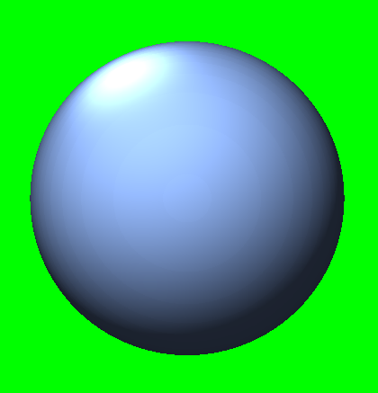
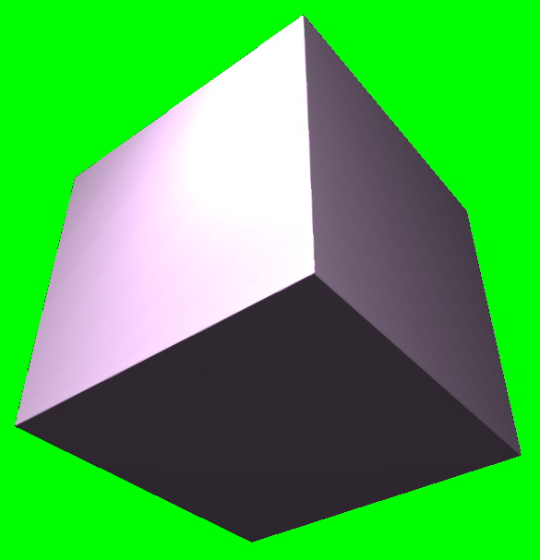
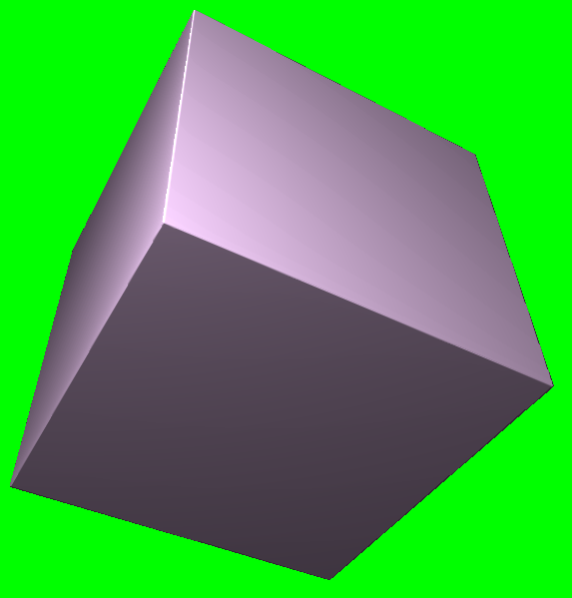
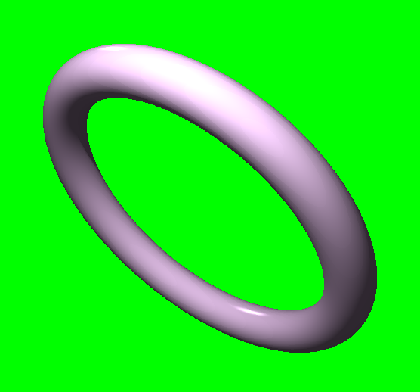
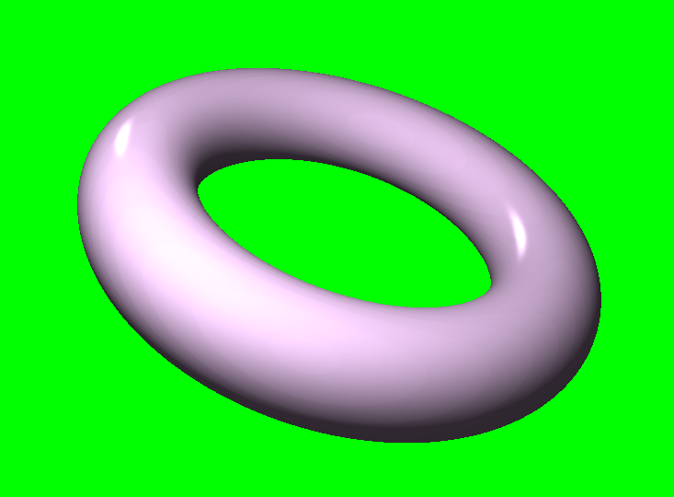
Utilising ray marching and signed- distance functions to render a scene of primitives
Anthony Sturdy
18015368
BSc (Hons) Computer Games Programming
Dr. David White & Craig Weightman

Slide 2
INTRODUCTION
Use of ray tracing recently brought to the forefront of real-time rendering.
Ray marching shares many similarities to ray tracing.
Differences:
Shapes defined by maths.
Method of finding intersection.

Slide 3
AIM & OBJECTIVES
This research aims to explore the areas needed to produce a rendering engine that utilises ray marching as a method of rendering a 3D scene and to take advantage of the characteristics of ray marching to achieve various visual effects.
OBJECTIVE 1
Develop performant, real-time ray marching renderer.
OBJECTIVE 2
Implement rendering effects only viable in real-time with ray marching.
OBJECTIVE 3
Various visual effects typically associated with ray-based rendering.
OBJECTIVE 4
An engine framework surrounding the renderer, providing a graphical user interface for users to control objects within the scene.

Slide 4
BACKGROUND
Ray-based rendering is computationally expensive compared to other traditional rendering techniques such as rasterisatiton. Ensuring the project remains performant, and real-time, would prove the biggest challenge for this project.
Allow user to add/remove/modify objects.
Allow for custom object shapes (SDFs).
Provide a variety of visual effects.
Avoid limiting the user.

Slide 5
RESEARCH METHODOLOGY
WATERFALL Linear Prevents scope becoming out-of-proportion KANBAN Flexible Allows for iteration and simultaneous feature development SCRUM Keeps team aligned Promotes iterative development SCRUMBAN Combines advantages of Scrum and Kanban Short sprints provide flexibility | The methodology chosen for this project is Kanban, for the flexibility offered with the ability to research and develop tasks simultaneously. Waterfall was too restrictive due to the linearity of the methodology. Scrum is most-effective when used in a team. Scrumban would also be unsuitable as it is most-effective when used in a team.

Slide 6
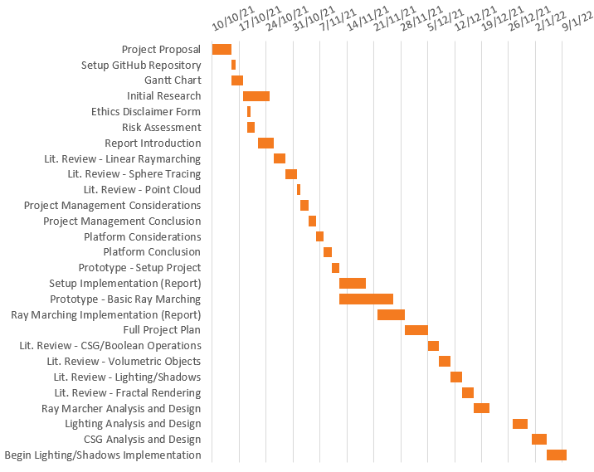
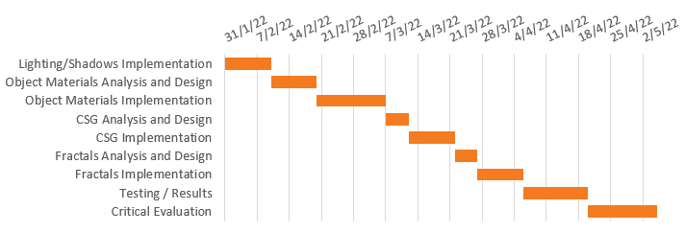
PROJECT PLAN
Gantt chart was used to plan the time taken for each feature.
Some features were able to be researched and/or developed simultaneously.
Towards the end of the project, larger features or report sections were allotted more time.

Slide 7












ANALYSIS
PLATFORM
Unity, DirectX 11, Vulkan
PLANNING
Trello, Microsoft Planner, GitHub Projects
IDE
Visual Studio 2022, CLion, Code::Blocks
VERSION CONTROL
Git, Subversion (SVN), Mercurial

Slide 8
DESIGN
PLATFORM
DirectX 11 was used for the development platform for this project.
PLANNING
The Kanban board was created and managed using Trello.
IDE
Visual Studio 2022 was the chosen IDE used to develop the project.
VERSION CONTROL
Git was used for version control, paired with GitHub to host the Git repository.
OTHER
C++
ImGui
DirectXTK

Slide 9
IMPLEMENTATION

Slide 11
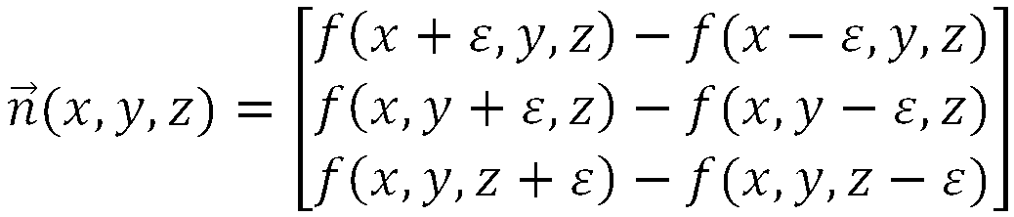
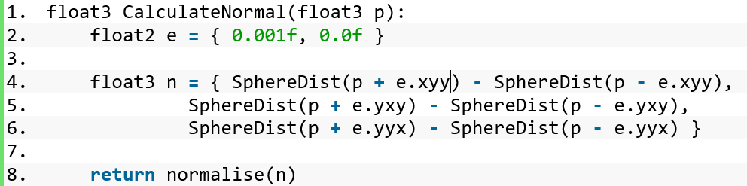
Distance to scene
Both equate to: p + float3(0.001,0,0)
Both equate to: p + float3(0,0.001,0)

Slide 12
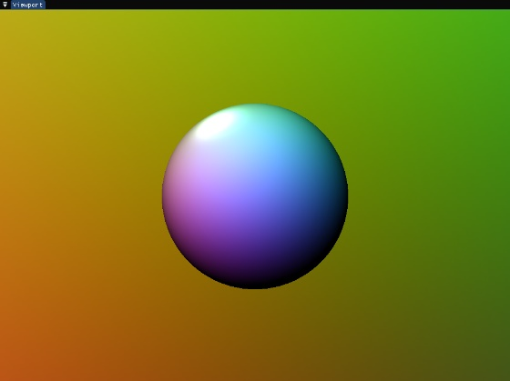




$$A=K_{a}C_{a}$$
$$D=\sum_{i ∈ lights}{(K_{d}\left(L_{i}∙N\right)C_{i,d})}$$
$$S=\sum_{i ∈ lights}{(K_{s}{\left(V∙R\right)}^{e}C_{i,s})}$$
$$L_{p}=(A+D+S)C_{p}$$

Slide 15
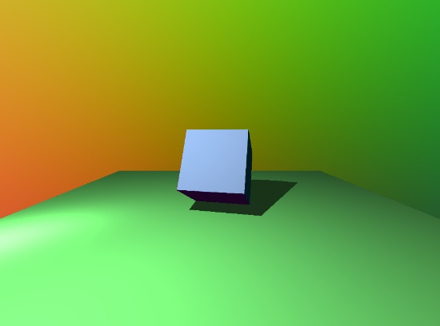
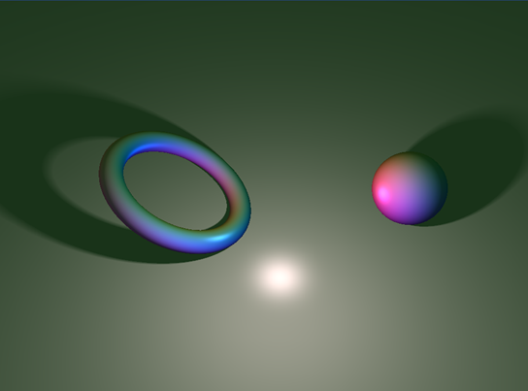

$$r=p∗d÷t$$
Total shadow value
Penumbra strength
Distance from scene
Distance ray has travelled

Slide 16
ADD
SUBTRACT
INTERSECT
min(a,b)
max(a,-b)
max(a,b)

Slide 17
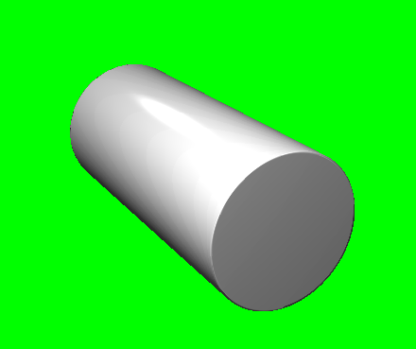
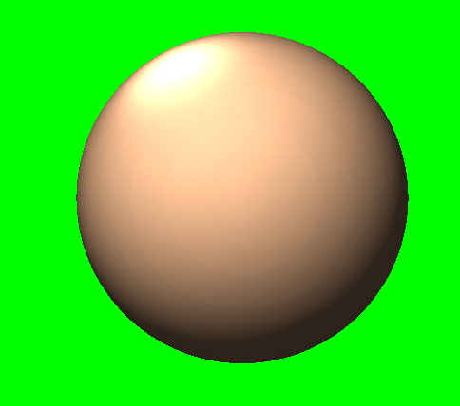
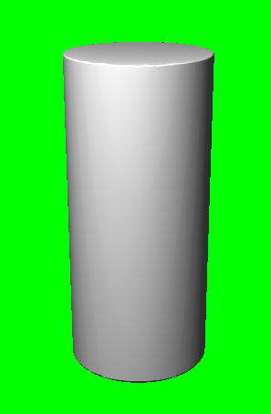
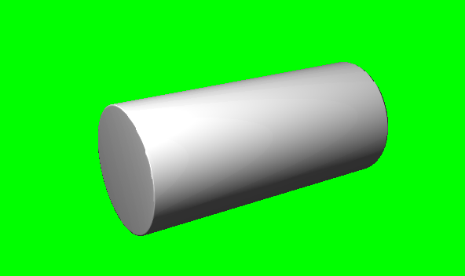

Slide 19
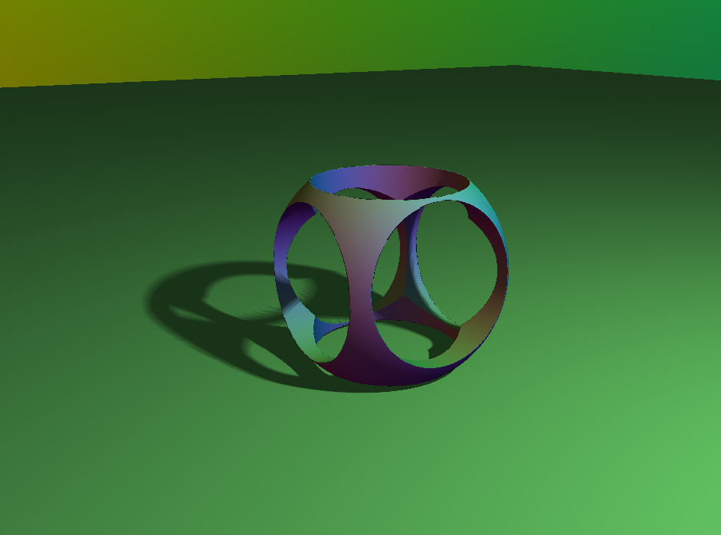

Slide 21
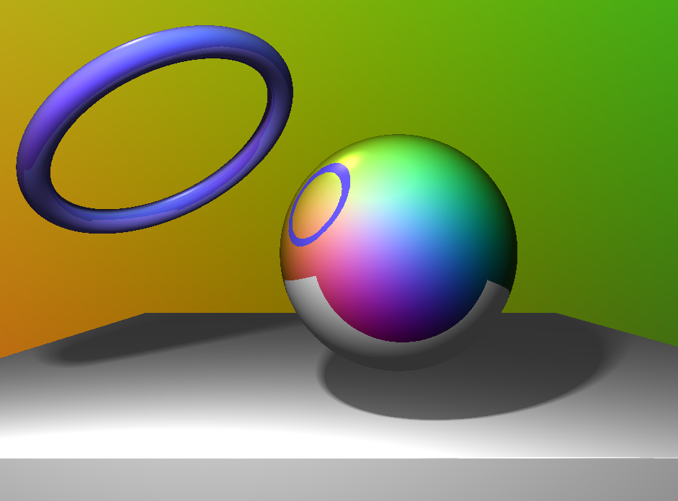

Slide 22
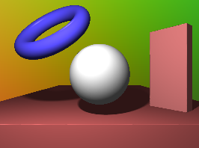
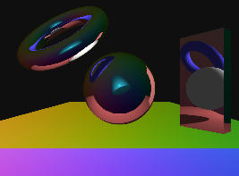

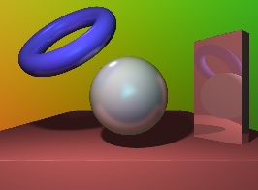


First Pass (Pixel Shader)
Second Pass (Compute Shader)
Colour Render
Reflections Render
Gaussian Blur
Combine

Slide 23


Slide 25
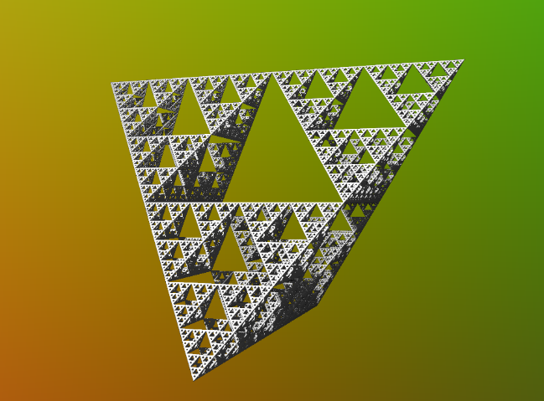

$$4^{10}=1,048,576$$

Slide 26



$$ao=1−s÷\frac{s_{max}}{a}$$

Slide 27
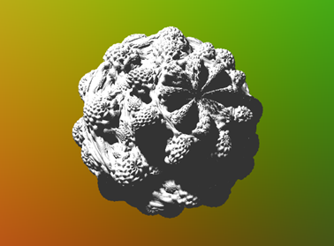
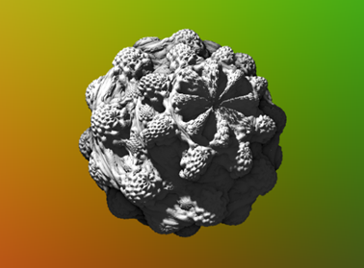

Slide 28
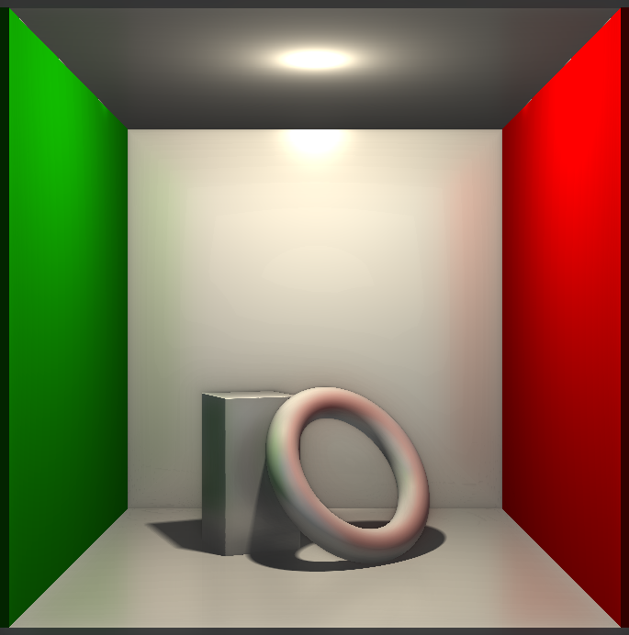
TEST PLAN
CORNELL BOX
Commonly used in graphics tests.
Controlled environment.
Used for all tests to find areas where the renderer excels or needs improvement.

Slide 29
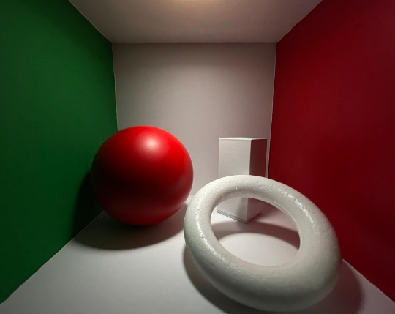
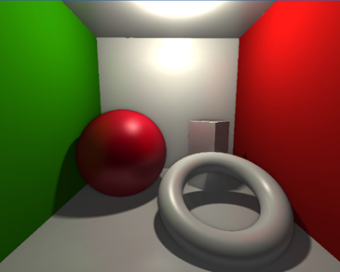
TEST PLAN
ORIGINAL
RENDER

Slide 30
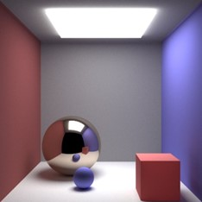
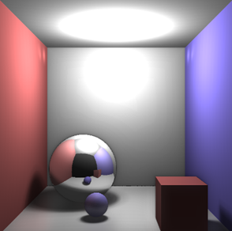
TEST PLAN
ORIGINAL
RENDER

Slide 31
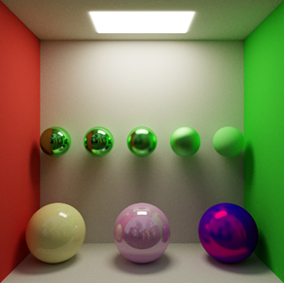
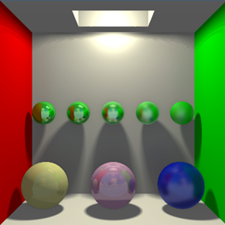
TEST PLAN
ORIGINAL
RENDER

Slide 32
Demonstration

Slide 33
CONCLUSION

Slide 34
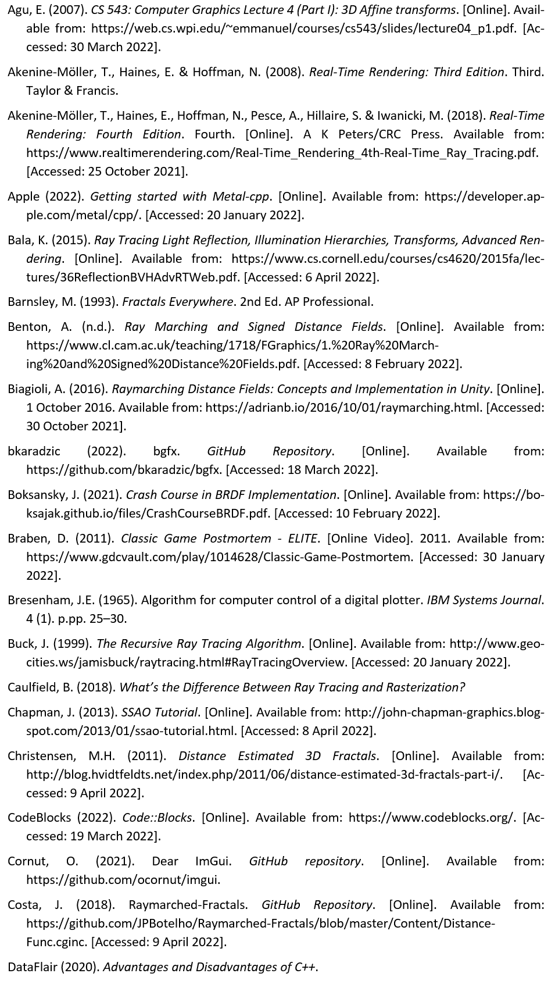
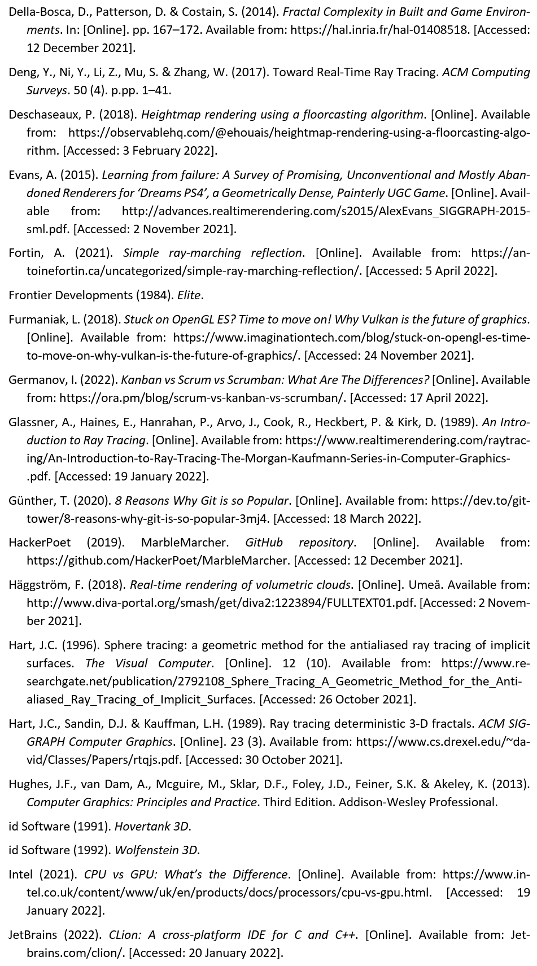

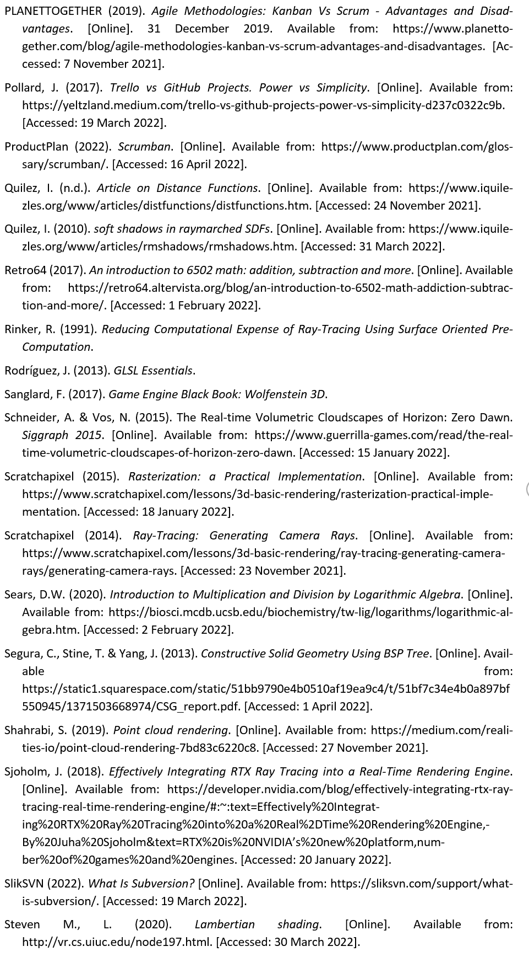
BIBLIOGRAPHY

Slide 35
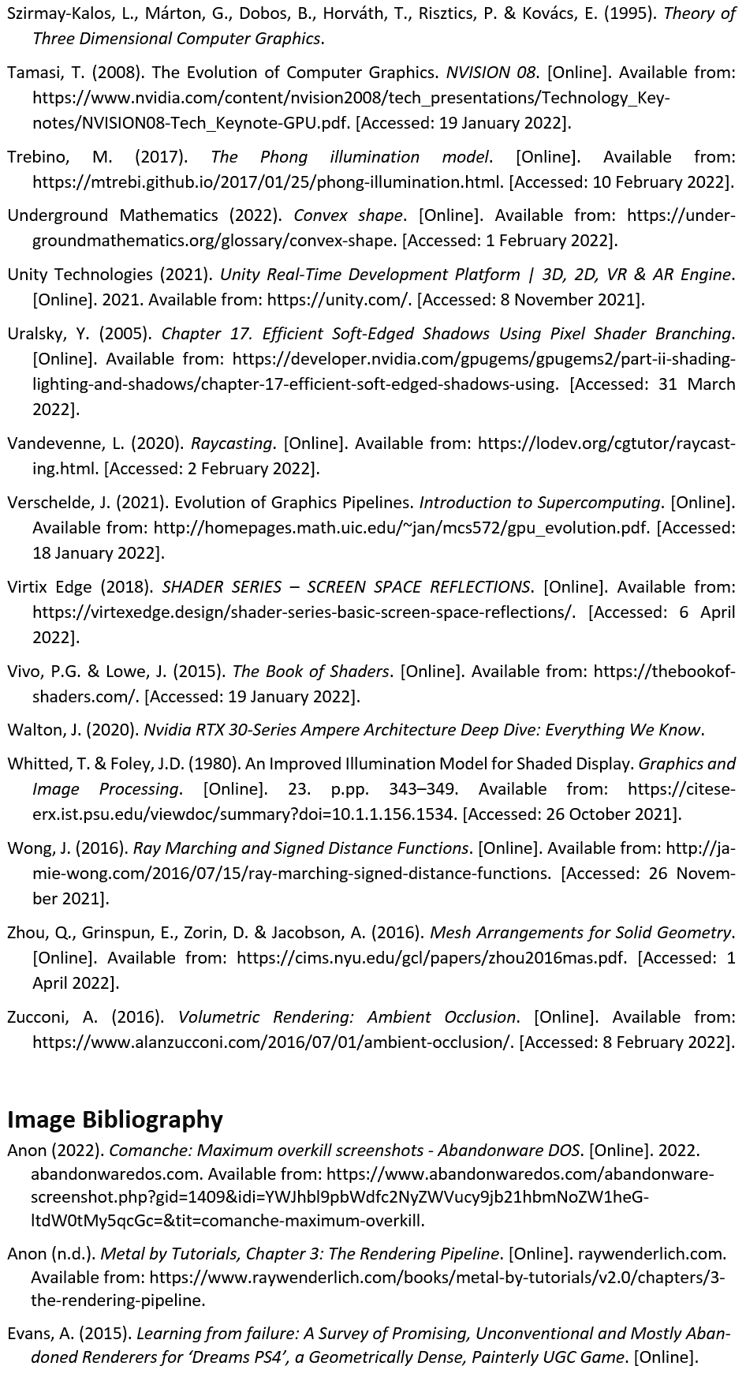
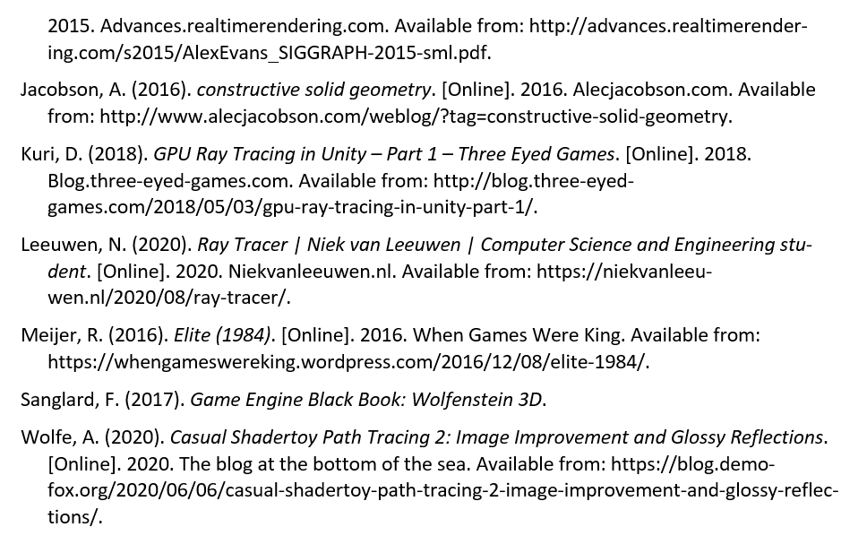
BIBLIOGRAPHY

Slide 36
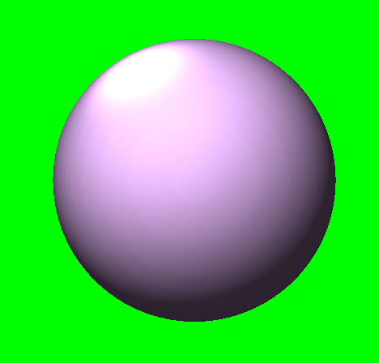
Questions
Utilising Ray Marching and Signed-Distance Functions to Render a Scene of Primitives
By Anthony Sturdy
18015368
BSc (Hons) Compute Games Programming
Dr David White & Craig Weightman

